Slide 1
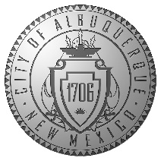
Cutler Avenue Pedestrian Improvements
08/16/2021

Slide 2
Welcome and Introductions

Slide 3
Agenda
01 | Project Description
02 | Project Layout – Plan View
03 | Project Typical Section
04 | Questions/Comments

Slide 4
01 - Project Description
Corridor Improvements
Roadway Mill and overlay, signing and striping, sidewalk, drivepads, curb ramps, gravel mulch landscaping.
Pedestrian Access Improvements
ADA/PROWAG compliant sidewalk, drivepads and curb ramps.
Protected parking via bulbouts.
Rapid flashing beacons at high volume pedestrian crossing.

Slide 5
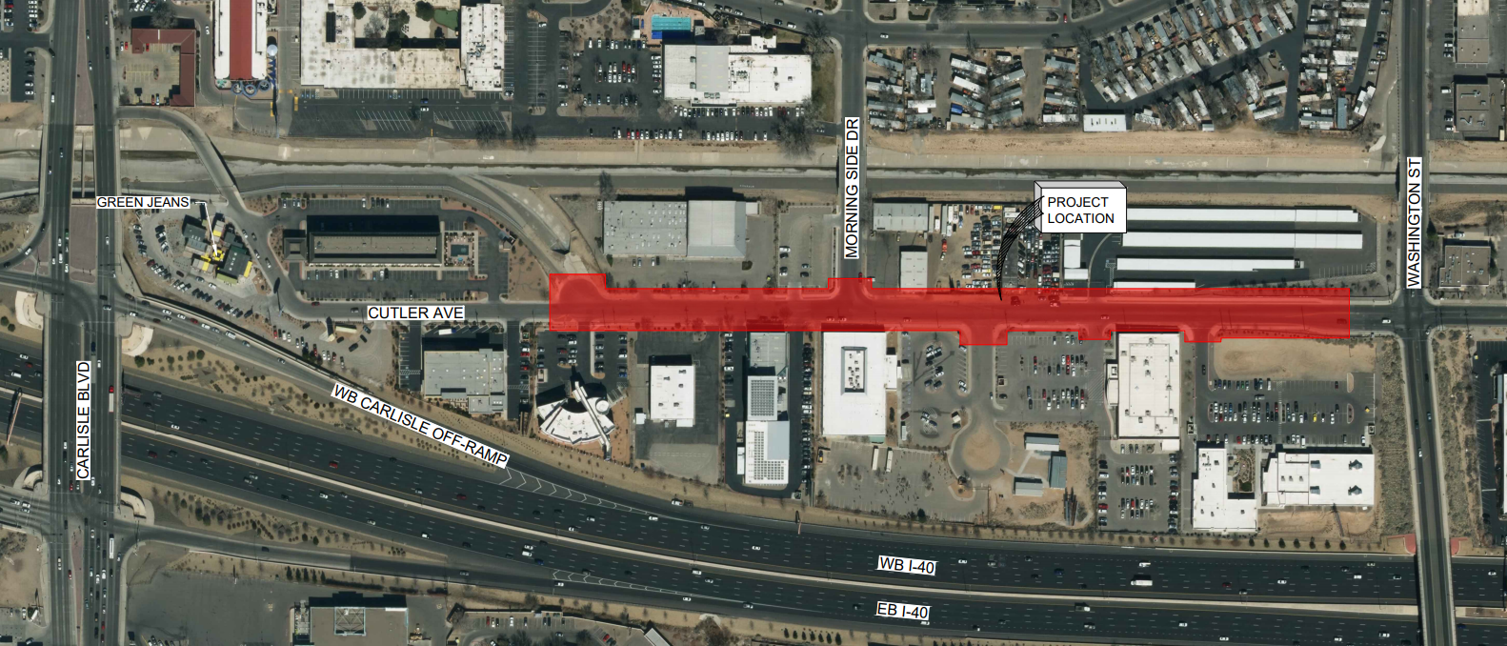
01 - Project Limits and Vicinity Map
Project limits: Cutler Avenue cul-de-sac to Washington Street
Project length = 0.30 miles

Slide 6
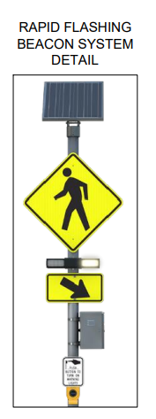
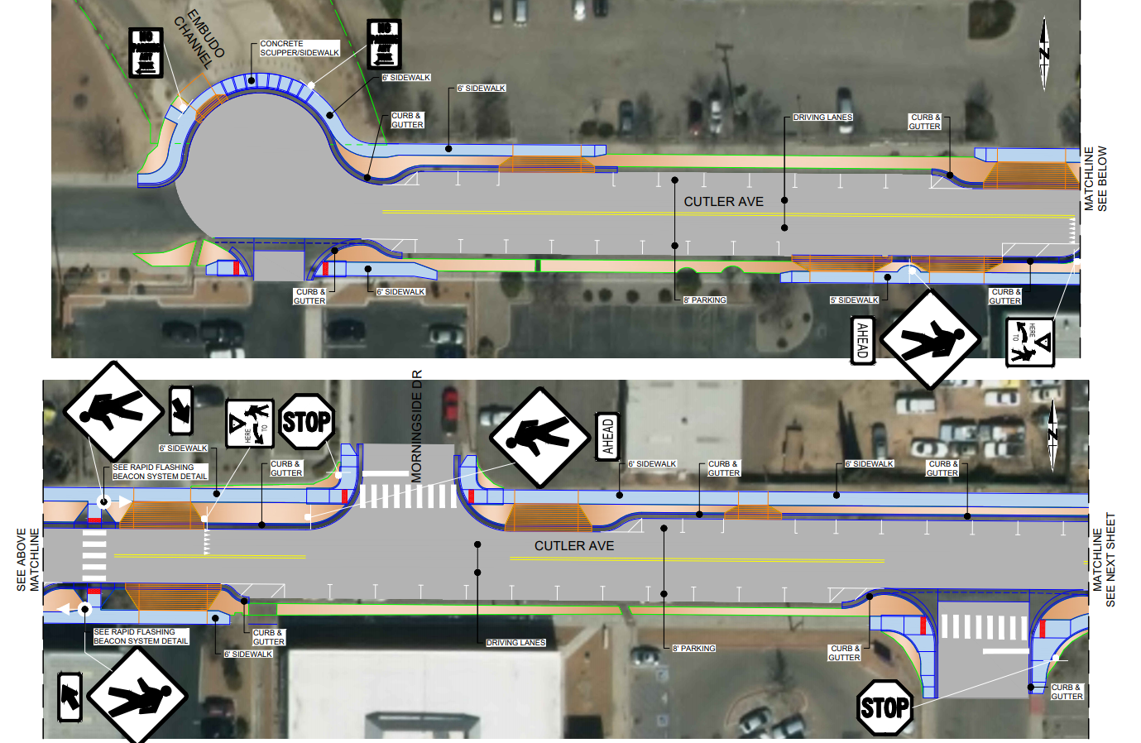
02 - Project Layout – Plan View, 1 of 2

Slide 7
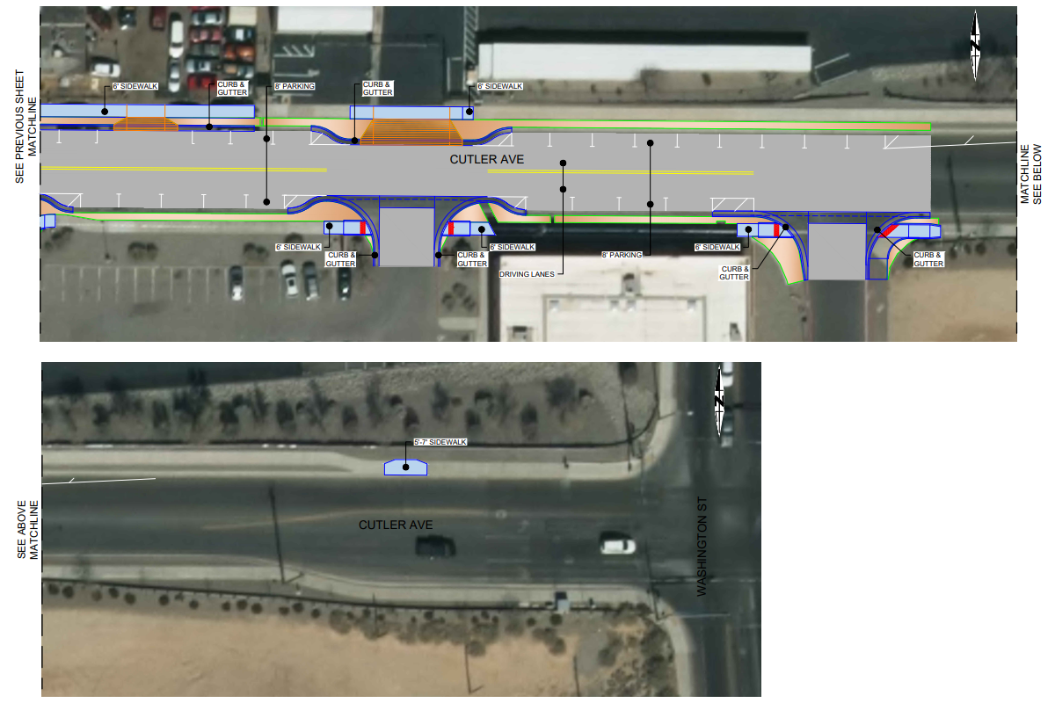
02 - Project Layout – Plan View, 2 of 2

Slide 8
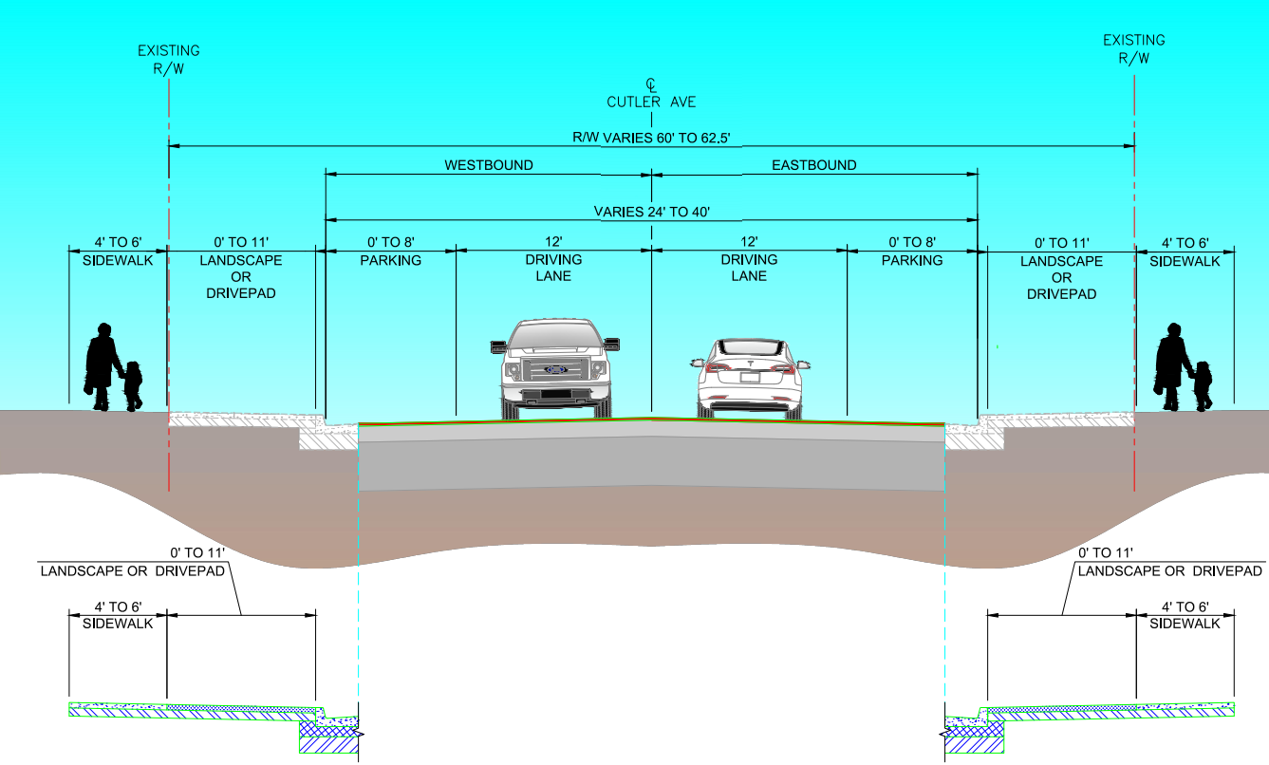
03 - Project Typical Section

Slide 9
04 - Questions/Comments

